Slide 1
Recruitment

Slide 2
Recruitment is a process of identifying, screening, shortlisting and hiring potential resource for filling up the vacant positions in an organization. It is a core function of Human Resource Management.
Recruitment is the process of choosing the right person for the right position and at the right time. Recruitment also refers to the process of attracting, selecting, and appointing potential candidates to meet the organization’s resource requirements.
The hiring of the candidates can be done internally i.e., within the organization, or from external sources. And the process should be performed within a time constraint and it should be cost effective

Slide 3
Importance of Recruitment
Recruitment is one of the most fundamental activities of the HR team. If the recruitment process is efficient, then –
The organization gets happier and more productive employees
Attrition rate reduces.
It builds a good workplace environment with good employee relationships.
It results in overall growth of the organization.

Slide 4
Factors that influence the recruitment process.
Internal Factors Organizations have control over the internal factors that affect their recruitment functions.
The internal factors are:
Size of organization
Recruiting policy
Image of organization
Image of job

Slide 5
External factors are those that cannot be controlled by an organization. The external factors that affect the recruitment process include the following:
Demographic factors – Demographic factors are related to the attributes of potential employees such as their age, religion, literacy level, gender, occupation, economic status, etc.
Labor market – Labor market controls the demand and supply of labor. For example, if the supply of people having a specific skill is less than the demand, then the hiring will need more efforts. On the other hand, if the demand is less than the supply, the hiring will be relative easier.
Unemployment rate – If the unemployment rate is high in a specific area, hiring of resources will be simple and easier, as the number of applicants is very high. In contrast, if the unemployment rate is low, then recruiting tends to be very difficult due to less number of resources

Slide 6
Labor laws – Labor laws reflect the social and political environment of a market, which are created by the central and state governments. These laws dictate the compensation, working environment, safety and health regulations, etc., for different types of employments. As the government changes, the laws too change.
Legal considerations – Job reservations for different castes such as STs, SCs, OBCs are best examples of legal considerations. These considerations, passed by government, will have a positive or negative impact on the recruitment policies of the organizations.
Competitors – When organizations in the same industry are competing for the best qualified resources, there is a need to analyze the competition and offer the resources packages that are best in terms of industry standards.

Slide 7
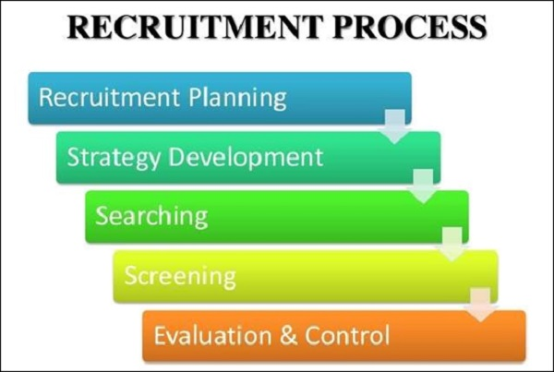
Recruitment Process

Slide 8
Recruitment planning is the first step of the recruitment process, where the vacant positions are analyzed and described. It includes job specifications and its nature, experience, qualifications and skills required for the job, etc.
Recruitment strategy is the second step of the recruitment process, where a strategy is prepared for hiring the resources. After completing the preparation of job descriptions and job specifications, the next step is to decide which strategy to adopt for recruiting the potential candidates for the organization.
Searching is the process of recruitment where the resources are sourced depending upon the requirement of the job. After the recruitment strategy is done, the searching of candidates will be initialized.
Screening starts after completion of the process of sourcing the candidates. Screening is the process of filtering the applications of the candidates for further selection process.
Evaluation and control is the last stage in the process of recruitment. In this process, the effectiveness and the validity of the process and methods are assessed. Recruitment is a costly process, hence it is important that the performance of the recruitment process is thoroughly evaluated.

Slide 9
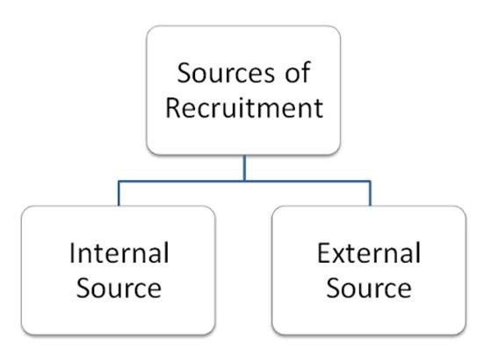

Slide 10
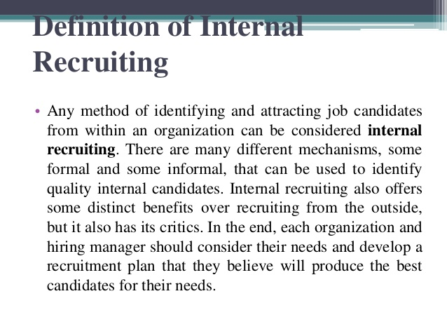

Slide 11
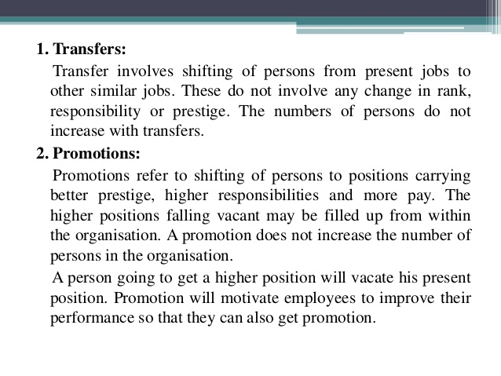

Slide 12
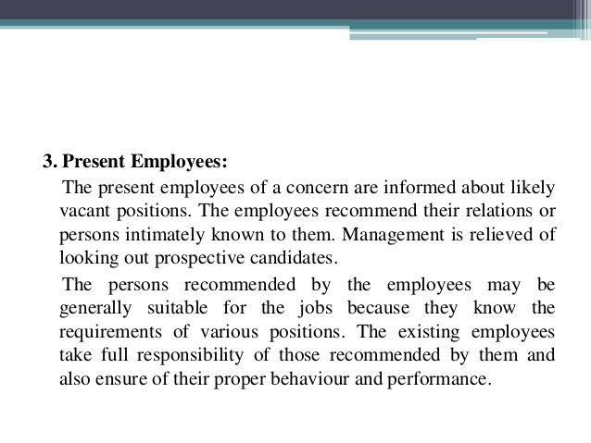

Slide 13
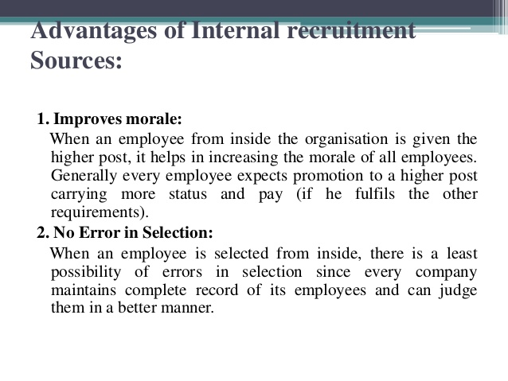

Slide 14
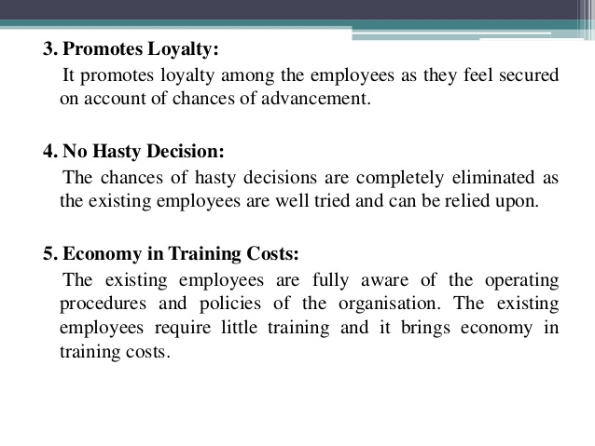

Slide 15
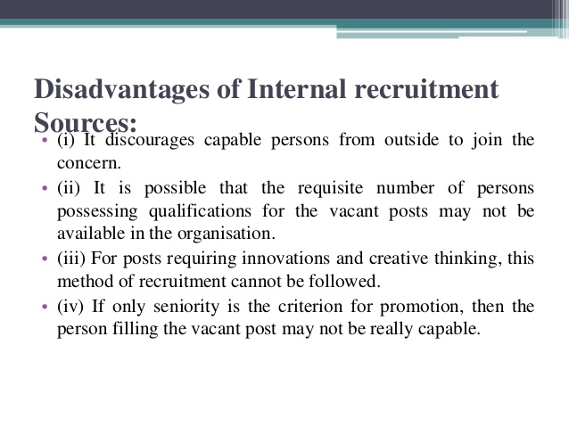

Slide 16
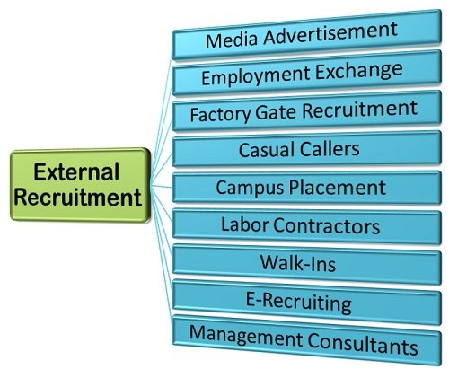
External sources of recruitment

Slide 17
1.Advertisements
To find the skilled and more efficient manpower giving advertisement for the vacant job position is the better way. Advertisements help in attracting the right candidates and in maximizing brand image. Advertisements may be given in print media or electronic media, it gives better results and it is cheaper than approaching third parties.
2.Job portals
With the growing technology and internet usage, job portals are playing a major role in finding right candidates for right jobs. Job portals can inform up to date job alerts to the candidates and offer attractive benefits and packages to the employers. The tools and techniques used by the job portals highly reduce the efforts in finding the skilled candidates.
3.Company’s websites
With the increase in business operations and globalization, the need for human resources is also increasing day by day. To face a severe competition and to reduce the cost during the long run, many companies are setting up their own websites for finding and attracting candidates with competitive skills.

Slide 18
4.Social networking sites
Communicating about vacant positions of the organization through social networking sites help in motivation and attracting the highly skilled and more efficient candidates to apply for the jobs.
5.Placement agencies
Approaching placement agencies reduces the time and efforts to find the right candidates from the pool of skilled candidates. They use various tools and techniques to filter the resumes and they send it to the companies for further processing. The main drawback of this method is commission basis on hiring the candidates.
6.Job fairs and walk in interviews
Walk in interviews and job fairs are declared and conducted by companies to find the skilled candidates. Following this method highly reduces efforts in finding more efficient human resources for the bulk requirement.
7.Campus interviews
This is an easy and economical method helps in finding eligible candidates, through this method organization can find energetic and more competitive candidates for suitable vacancies, this method is beneficial for both the candidates and companies.

Slide 19
Advantages of External Recruitment Process:
In an external recruitment process, the company posts a job and invites different candidates suitable for the job outside the company.
1. Increased chances:
In this increased chance, the company receives a variety and number of candidates who owns knowledge and ability to handle that job.
2. Fresher skill and input:
When a company goes with an external recruitment method, there is a quite better possibility of finding and identifying a fresher candidate who is capable of delivering new skills and inputs for the betterment of the company.
3. Qualified candidates:
Nowadays, when a company posts an advertisement in social media or newspaper. One common thing they look for is a well experienced and qualified candidate.
4. Better competition:
In the external recruitment process, there will be a chance of facing better competition in terms of hiring new talent.

Slide 20
Disadvantages of External Recruitment Process:
1. A limited understanding of the company:
When a candidate is selected from an external recruitment process, there is a possibility that the candidate might have less chance of understanding the environment of the company.
2. Higher risk:
There is a possibility that the candidate selected for the post is not worthy of the position offered and he/she can take advantage of their position in the company.
3. Time-consuming:
The main disadvantages of external recruitment are that it is time-consuming as most of the companies post an advertisement for their company recruitment drive.
4. High costs:
As most part of the external recruitment process mainly deals with complete new candidates then the company needs to come up with a pay scale for that candidate which should value his/her skill and ability.
5. Internal disputes with existing employees:
When a company considers a fresh candidate for the higher post than the existing candidates, then there is a higher possibility that the company existing employees might show some sort of internal dispute among the officials of the company.

